Slide 1
Elizabeth Blackwell Institute Lecture
Genomics and Healthcare – New Opportunities
Professor Dame Sue Hill @CSOsue sue.l.hill@nhs.net
Chief Scientific Officer for England and Senior Responsible Officer for Genomics in NHS England

Slide 2
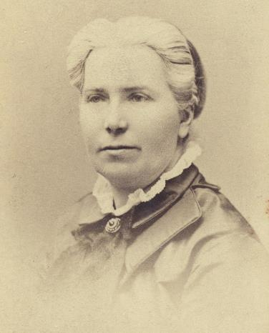
Elizabeth Blackwell - honouring a trailblazer
Originally from Bristol, she emigrated to the US with her family and went on to become the first woman to receive a M.D. from an American medical school.
Later she became the first woman to be placed on the General Medical Council’s medical register.
Pioneered in promoting education for women in medicine
She set-up the National Health Society and used the motto ‘Prevention is better than Cure’ – a motto all of us in healthcare live by.

Slide 3
Setting the context

Slide 4








Securing a sustainable healthcare system
– in Dr Blackwell’s spirit
Challenges for healthcare systems
delivering affordable healthcare - value to payers
partnering with other sectors to address social determinants of health
increasing rates of non-communicable diseases
providing equity of access
aging populations - increasing numbers of people living with multiple long-term conditions
meeting individual’s needs through coordinated, convenient & accessible care
delivering high-quality care
The future direction for healthcare systems
at one end, a focus on improvements to population health
A step change in prediction and prevention of disease
Earlier diagnosis of disease
Enhanced screening and prediction
Influencing lifestyle choices
at the other, increasing personalisation & management approaches
Tackling the limits of ‘one size fits all’ medicine & blockbuster drugs
Medicines optimisation
Managing adverse drug reactions
Identification of new targets and treatment approaches
Improving outcomes
Personalised care
Population Health
Notes:
Ongoing reanalysis for patients without an

Slide 5
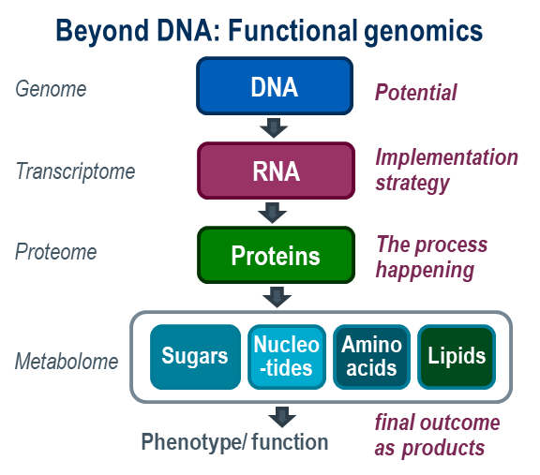
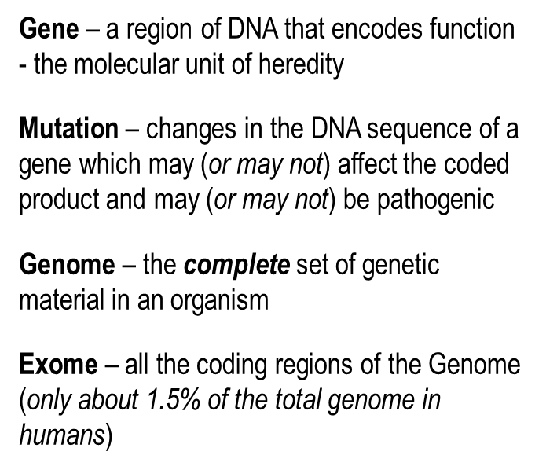
Genomics encompasses the spectrum of testing
The World Health Organisation defines:
Genetics as the study of heredity.
Genomics is defined as the study of genes in our DNA and their functions, and related techniques.
From single genes, to whole genome sequencing and will stretch beyond DNA

Slide 6
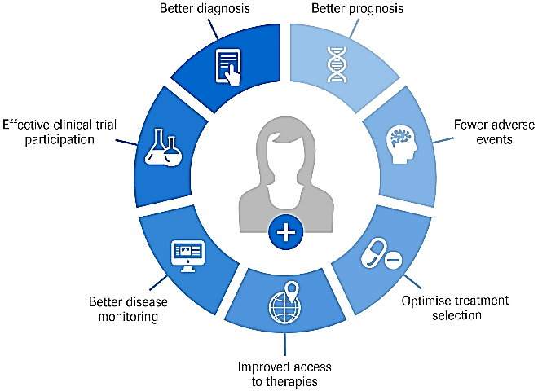
Genomics and the potential for healthcare
NHS genomics encompasses the full WHO definition – from single gene to WGS, from DNA to metabolomics
the future use of genomics
Protocol-based medicine
Data-driven healthcare
Volume-based healthcare
Value-based healthcare
‘one-size fits all’ approach
Better care tailored/stratified treatments, medicine optimisation

Slide 7
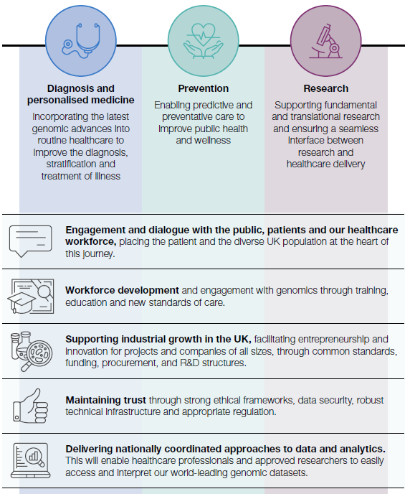

Genome UK Strategy
Over the next 10 years the Government’s ambition is to create the most advanced genomic healthcare system in the world, underpinned by the latest scientific advances, to deliver better health outcomes at lower cost.
It will incorporate the latest genomics advances into routine healthcare to improve the diagnosis, stratification and treatment of illness.
Harness the power of health data to make the UK the best place in the world to access genomic data responsibly, ensuring equity of and diversity of access and using this to inform all parts of a patients care.

Slide 8

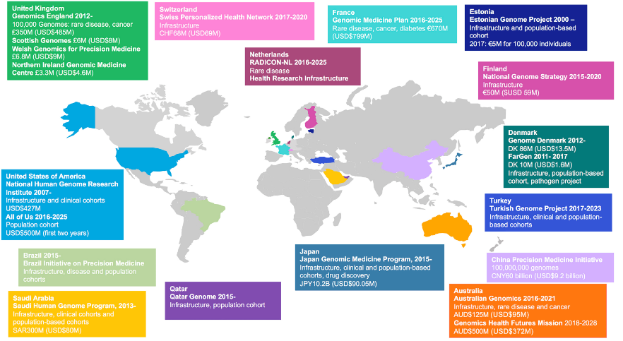

Genomics is also a global initiative with potential for collaboration
A policy-framing and technical standards-setting organisation, seeking to enable responsible genomic data sharing within a human rights framework
An independent not-for-profit charitable organization identifying opportunities to foster global collaboration to demonstrate value and the effective use of genomics in medicine
Source: STARK, Z., et al. (2019). Integrating genomics into healthcare: a global responsibility. American Journal of Human Genetics. Published online 03 01; DOI: 10.1016/j.ajhg.2018.11.014
Notes:
Since 2013, the governments of at least 14 countries have invested over US$4 billion in establishing national genomic-medicine projects initiatives.
Sharing data, tools, experience, and knowledge to create a global “learning health system” is essential if we are to effectively accelerate and sustain the integration of genomics into healthcare.

Slide 9

Genomics driving transformation in healthcare in the UK

Slide 10





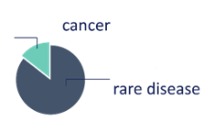


A catalyst for change : 100,000 Genomes Project
Patient consent
107,513 genomes available in the Research Environment
122,945
Sequencing centre - Illumina
Samples + clinical data + longitudinal data
Biorepository
Samples collected and received at the UK Biocentre
33,333 cancer
74,180 rare disease
Frontline services involved
13 NHS Genomic Medicine Centres
Primary clinical data:
89,335 participants
Validation & reporting in NHS labs
Genomics England
Informatics Architecture
36,872
86,073
MDTs & return of results to participants
Discovery Forum
Industry Users
GeCIP
Scientific & Clinical Users
17,346 cancer
71,989 rare disease
new treatments
&
other discoveries
Creating direction
Leading transformation
Building readiness
Notes:
The strategic approach to delivery sought to:
Improve our understanding and evidence of the impact of WGS in the NHS to inform the future commissioning approach.
Enable people from across the country to join the Project to reflect diverse ethnicity of the population.
Better enable genomic services to be designed around the people using and interacting with them.
Create strong partnerships and clinical leadership across geographical areas to drive service improvements and share good practice via a lead provider model.
Direct investment to support transformation across the system rather than investing in a couple of specialist centres.
Broaden the knowledge, and use of, genomics across medical specialities eg oncology, cardiology, neurology
Develop the underpinning informatics and data architecture within the NHS

Slide 11
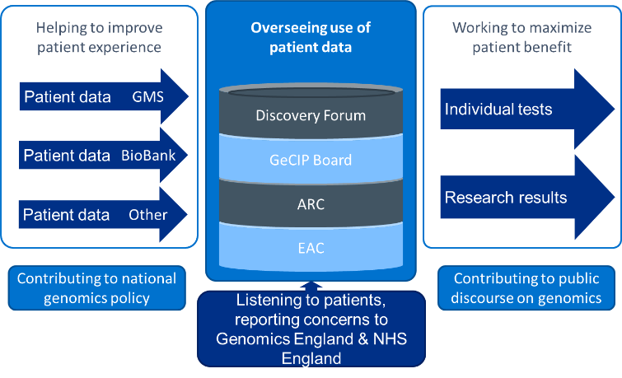
Evolving the role of participant panel – putting patients at the heart
The National Participant Panel at Genomics England together with work in the NHS GMCs participants were at the centre of the 100,000 Genomes Project by
Making sure experiences of participants were at the heart of the Project
Responding to feedback
Providing practical ethical and governance oversight, including overseeing who should have access to participant data
The importance of ethics featured strongly in the Chief Medical Officer’s report Generation Genome and through ongoing public dialogue work around developing attitude to genomics.

Slide 12
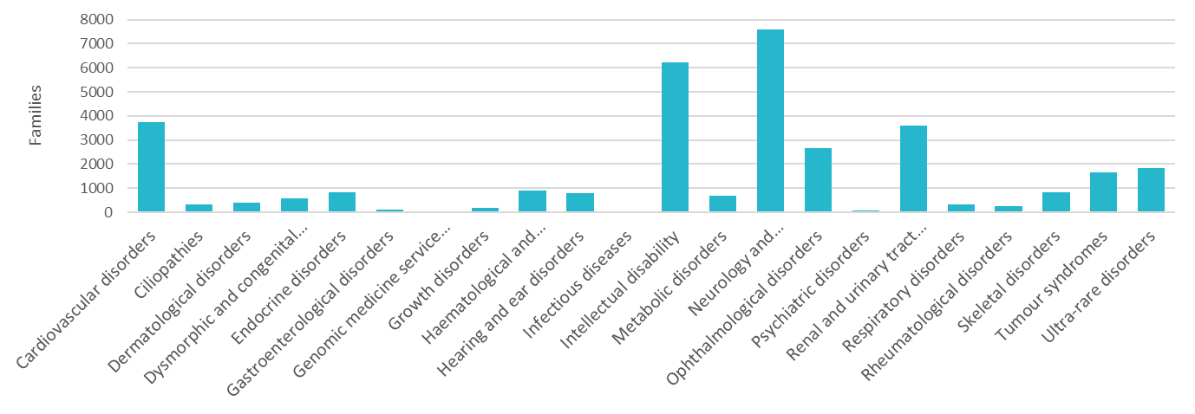
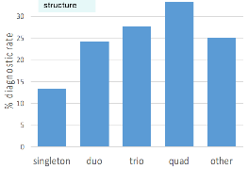
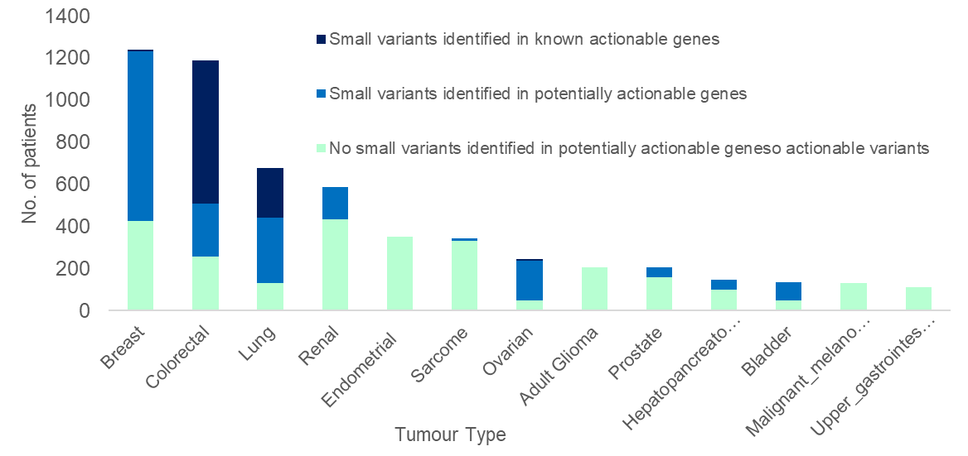
The Project focused on rare disease & cancer
Rare disease
1,200 disorders with unmet need
Standardised eligibility & phenotyping which
enhanced diagnostic yield ( circa 25% over standard of care increasing to 40- 50% in some disorders)
Some of these end a diagnostic odyssey of years
Genomics England developed innovative semi-automated analytics
Greater HPO characterisation resulted in enhanced diagnostic yield
Cancer
24 cancer types included and total of 18,500 participants
Identification of somatic small variants in 136 potentially actionable genes across all solid tumours (n=5700)
50% have a known actionable or potentially actionable gene identified - tumour specific early phase clinical trials

Slide 13









But it’s the outcomes that really matter
Jessica’s story
Diagnostic discovery for patients
Genomics England Clinical Interpretation Partnership in numbers
Jessica, aged 4
Rare condition causes epilepsy, affecting movement & development.
Took part in the project with parents at Great Ormond Street Hospital.
GeCIP launched in June 2014 @ Wellcome Trust
3344 researchers world-wide
121 Project publications
22 Successful grant applications
Found a genetic variant in the SLC2A1 gene - makes a protein that transports a certain type of sugar into the brain. Mistakes in the SLC2A1 gene can cause ‘Glut1 deficiency syndrome’
In some patients who have Glut1 deficiency syndrome a very low-carbohydrate diet (ketogenic) can help reduce the number of seizures.
Thanks to WGS, Jessica’s clinician was able to recommend this diet for her, which helped with her seizures.
175 institutions with signed Participation Agreement
3083 researchers with access to data
141 diagnoses returned to NHS laboratories since January 2020
Collaborations contributing to patient care:
  Proband diagnosed with osteogenesis imperfecta
  Researchers identified compound heterozygous variants in a known OI gene
  One variant was a 1.7Mb deletion, and the other was an intronic variant predicted to affect splicing
  Result had immediate relevance for the next generation in the family
  Recruiting centre collaborating with researchers to test and confirm both variants
Further 135 variants undergoing triage to establish suitability for return to the NHS

Slide 14
Still more to do and learn – work is continuing to complete the Project
Reanalysis of results
Improving care - pharmacogenomics & additional
looked-for findings
Understanding the impact on NHS Services
Lots of challenges and opportunities ahead, insight to gather and big questions to answer:
Reanalysis of results - when, what and frequency to reanalyse? Potential implications for patients, resources and clinical time. Balancing the need to meet demand for new patients versus management of patients already in the system.
Results yet to be returned for pharmacogenomic and additional looked-for findings however have opportunities to improve care from a single WGS test . What impact do they have on NHS services? On participants and professionals ?
What should the criteria be for introducing incidental and additional looked-for-findings into the NHS – role of the UK National Screening Committee, threshold for evidence etc.
Understanding clinical utility of new and emerging approaches, eg Polygenic Risk Scores and relationship to risk profiling

Slide 15
Creating the future NHS service

Slide 16

The NHS Long Term Plan has set the strategic focus on genomics for the next 10 years
Technology
Targeted investment in
areas of innovation that
we believe will be
transformative, particularly genomics
NHS Genomic Medicine Service will sequence 500,000 whole genomes by 2023/24.
Improving recruitment to clinical trials and supporting research
Cancer
Rapid Diagnostic Centres
Access to personalised care
Stratified follow-up pathways
Earlier diagnosis
Extended access to molecular diagnostics
Genomic testing routinely offered to all people with cancer
Children & Young people
A strong start in life for
children and young people
All children with cancer to be offered WGS
Seriously-ill children likely to have genetic disorder to be offered WGS
Cardiovascular
Early detection and treatment
Rapid identification of high-risk conditions
Expanding access to genomic testing for Familial Hypercholesterolaemia
Research
Patient benefit from research
and discovery
Linking and correlating genomic, clinical data and patient data Provide routes to new treatments, diagnostic patterns and help patients make informed decisions about their care

Slide 17

NHS Genomic Medicine Service launched in October 2018
The NHS will have a national NHS Genomic Medicine Service providing consistent & equitable care for the country’s 55 million population with :
National approach to patient consent, patient & public involvement & strong ethical framework
Common national standards, specifications, protocols, contracts, activity monitoring & pricing frameworks
A consolidated national genomic laboratory network made up of seven Genomic Laboratory Hubs with quality at the core & driving rapid adoption of technology
Partnerships across local providers to support front-line delivery -building on NHS GMC model & integrated with clinical specialties across secondary/tertiary care to primary care & with linked workforce development
A single national testing directory –covering use of all technologies from single gene to whole genome sequencing inclusive of cancer
A national genomic knowledge base to inform academic & industry research & discovery including clinical trials recruitment
Single, national co-ordination and oversight of the service from the genomics unit in NHS England & NHS Improvement

Slide 18








NHS GMS Infrastructure
NHS Genomic Medicine Service
Clinical genetics services
Informed patients & clinical teams
National Genomic Testing service
Ongoing research & discovery
NHS Genomic
Laboratory Hubs
UK genomic
knowledge base
Test ordering & Genomic MDT clinicians
Patients & families
National Genomic
Test Directory
National Whole Genome Sequencing provision
Whole Genome Sequencing interpretation & decision support
Elements delivered in partnership with Genomics England
Genomic Medicine Service Alliances
Multidisciplinary clinical leadership to embed genomic medicine across end-to-end patient pathways through engagement with networks across defined geographies
Workforce development and education
Integrated & co-ordinated workforce development linked to HEE Genomics Education Programme and appointed workforce development leads
Notes:
GMS Alliances
Co-ordination, engagement & networks across defined geographical areas with funded and distributed clinical leadership - linked to personalising treatments and access to clinical trials
Nursing and midwifery collaborative, pharmacy & medical network
Clinical Genetics and counselling
Networked approach, genomic MDTs supporting clinical actionability.
Alignment & co-ordination with cancer alliances & networks
Networked approach, genomic tumour boards supporting clinical actionability
Alignment & co-ordination across clinical specialities eg cardiovascular
Networked approach, supporting clinical actionability
Research networks
facilitating access to genomic data and samples to enable research to be delivered at scale and speed

Slide 19


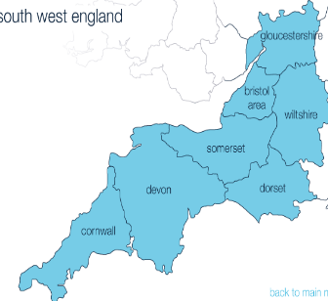




Bristol and Exeter within National NHS
Genomic Partnerships
South West NHS Genomic Medicine Service Alliance*
Bristol Genetics Laboratory
Cheltenham
Gloucester
North Bristol
Exeter Genomics Laboratory
University Hospitals Bristol and Weston
North Bristol
Royal Devon and Exeter
UH Bristol
Bath
Weston
2015-2019
2018 →
2021 →
* In proposal
Notes:
University Hospitals Bristol hosted WoE Genomics Medicine Centre. Andrew Mumford was Clinical Director: >5000 Genomes: University of Bristol was a partner organization
SWGLH is a partnership between purpose built clinical genomics laboratory at North Bristol and the Exeter Genomics Laboratory
Both Bristol teaching hospital Trusts are proposed co-hosts with Exeter in the future proposed SW NHS GMSA

Slide 20
Delivering the full breadth of genomic testing
NHS Genomic Medicine Service and Test Directory have a deliberate focus on the whole continuum of genomic testing
continuum OF Genomic Testing
Disease focussed
Informing treatment decisions
Population based
Predictive
And the full repertoire of testing technologies
TARGETED TESTIG
PANELS
EXOME SEQUENCING
WHOLE GENOME SEQUENCING
Known causes of genetic disease
eg Huntington’s Disease
Single test covering 10s – 100s of genes
Looking across the genome for diagnostic, therapeutic and predictive information
Inc. cascade testing to identify FH, BRCA, Lynch Syndrome
Standardising cancer panels for pan-solid tumour, pan-Haematological and specialist rare disease
Potential for PGx panel and polygenic risk scores
Standardising rapid NICU/PICU testing
Fetal Exome testing
Interim testing while WGS established
Phase 1 – 21 rare disease conditions and 3 cancers
Phase 2 – additional 25 rare disease conditions

Slide 21
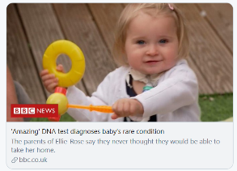
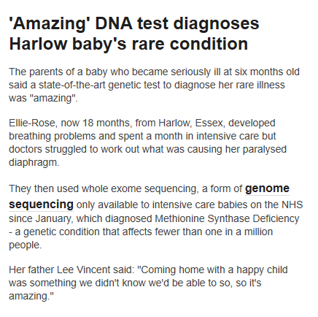
National rapid exome sequencing service for NICU & PICU patients
For acutely unwell children with a likely monogenic disorder where a genetic diagnosis would guide clinical management and treatment
Commissioned from October 2019 with 520 referrals to date, results reported in an average of 10 days and a genetic diagnosis in 37% of patients – at least 10 cases where genetic diagnosis changed treatment
Several patients have responded to treatment started as a consequence of the diagnosis, many others have been referred to specialist services and all diagnoses have provided information for families regarding the cause of their child’s disorder and the risk to future pregnancies:
Ellie Rose:
She was extremely ill until she was 18 months old when sequencing through this service revealed she had a condition where her diaphragm was paralysed. She is now receiving treatment and is progressing extremely well at home
Extension to include children with a severe COVID-19
Children treated in PICUs with proven or suspected COVID-19 with clinical features suggestive of an underlying primary immune or syndromic disorder.
6 referrals to date
A genetic diagnosis of LRBA deficiency ( a rare genetic disorder of the immune system) identified in a 10 year old with a recurrent inflammatory disorder and recent PICU admission that may have been triggered by SARS CoV-2 infection
Treatment with abatacept, a soluble CTLA immunoglobulin fusion protein, can partially restore T-cell regulatory function. Bone marrow transplantation may be required to achieve complete remission.
https://www.bbc.co.uk/news/av/uk-england-essex-53338445/amazing-dna-test-diagnoses-harlow-baby-s-rare-condition

Slide 22



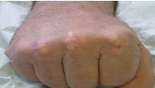



South West GLH familial hypercholesterolaemia service
Familial disorder of lipid metabolism
Estimated prevalence 1/250 in the UK
Elevated LDL-C; premature atherosclerosis
Increased risk of acute cardiac events
Genomic Testing Provides;
  Certainty and better acceptance of diagnosis
  Improved treatment compliance 93% vs 39% after one year (Lancet 2001;357:165)
  Facilitates family cascade testing
    Early diagnosis and treatment to PREVENT adverse events
First High Throughput NGS Service for FH (2013)
5 genes (monogenic) and 12 LDL-C raising SNPs (polygenic)
Sharing expertise to develop testing in other GLHs
Standardising Variant Classification –FH ClinGen VCEP
Inputting to NHS group to evaluate polygenic SNPs for commissioning
100,000 genomes FH GECIP to find rare causes of FH
Case finding in Primary Care – FAMCAT lab
National Genomics Training for FH nurses
UKAS 9307
ISO15189:2012

Slide 23
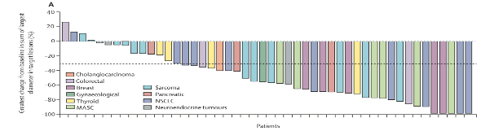
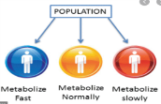
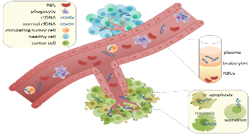
New cancer services in the South West – 2020
Large gene panel analysis being introduced
All South West SIHMDS working together
Tumour BRCA for Ovarian cancer to detect patients suitable for PARP inhibitors
Gene fusion analysis for NTRK
Gene fusion analysis in NSCLC
MSI analysis in newly diagnosed Colorectal cancer being delivered (DG27)
  Service being developed to meet new guidelines (DG42) for endometrial cancer
DPYD analysis to predict toxicity to fluoropyrimidines
ctDNA in NSCLC
Routine and frequent (weekly) GTABs
Lancet Oncol. 2019 Dec 11. pii: S1470-2045(19)30691-6.

Slide 24
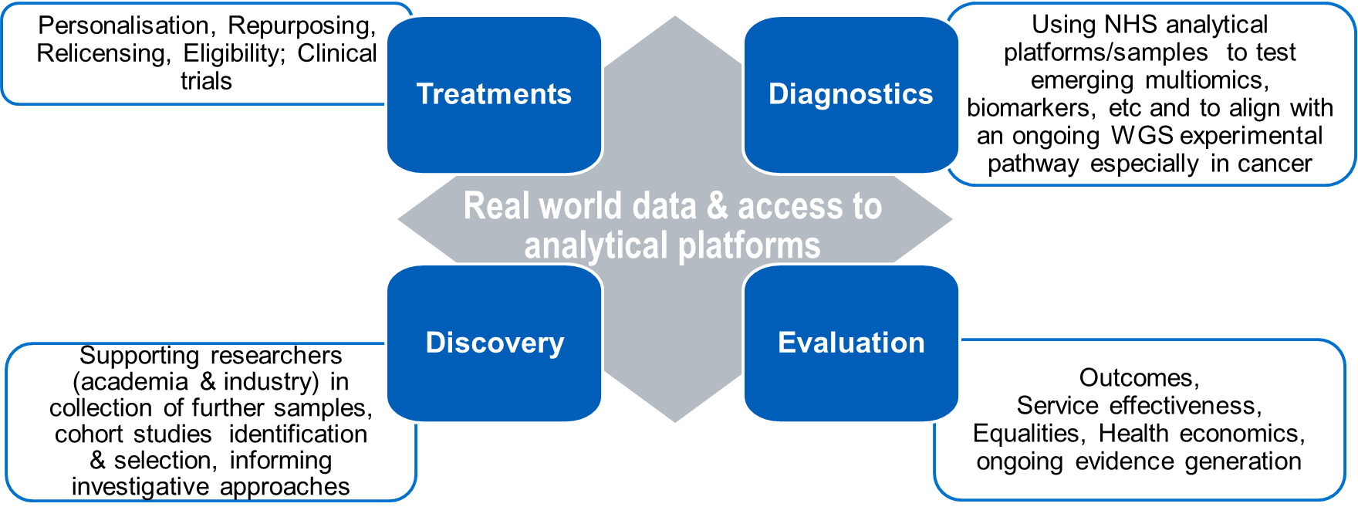
Establishing a shared platform for diagnostics and research
Shared platform for diagnostics & research
A framework to identify and recruit cohorts and trial-eligible patients
Ongoing record of research & diagnostic genomic analyses of each individual
Longitudinal life course data from national data sources held alongside data provided by researchers, clinicians & patients
Integration with external systems including hospital LIMS via APIs and standardised message formats e.g. FHIR
Driven by key principles:
All research for potential benefit of patients and the outcomes fed back to the NHS.
Align and to strategic priorities of the NHS and UK life sciences sector.
Genomic data will be deposited into the Library in a common format, within the restrictions imposed by any Intellectual Property and contractual obligations
NHS England working with Genomics England, DHSC and NIHR to develop a research framework for the NHS Genomic Medicine Service Research Collaborative.
This will support the facilitation and coordination of genomic research and clinical trials to ensure maximum benefit for patients and the NHS.

Slide 25

Interface with research driving clinical improvements
Patient
Healthcare
Research
Making “the Loop” work as an efficient, robust and scalable system will help…
  …patients, as we enable dialogues on consent, diagnosis, prognosis and treatment
  …healthcare teams, as we provide reliable genomic insights that are easy to request and interpret
  …researchers, as we accelerate research by providing data, infrastructure, insights and environment to collaborate and accelerate fundamental and translational research

Slide 26


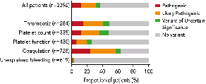

Clinical genomic achievements in Haematology
Research
Clinical Translation
Design and validation of next-gen panels for blood disorders
Implementation of NHS diagnostic gene panels for Clinical Haematology
Coordination of national GLH providers for Haematology genomics
-Standardised reporting
-Data sharing
-Genomic MDTs
Enrollment of patients with blood disorders disorders to 100,000 Genomes Project Pilot
  Phenotyping methodology
  New gene discovery using WGS
  Proof-of clinical concept
*
Turro et al. 10.1038/s41586-020-2434-2
Downes et al. 10.1182/blood.2018891192
https://panelapp.genomicsengland.co.uk/

Slide 27

Personalising Medicine

Slide 28
Mainstreaming : A focus on end-to-end pathways – a vision that Dr Blackwell held
Prevention
Early identification/ Prognosis
Diagnosis
Treatment selection
Monitoring/ recurrence
most effective approach – with fewest side-effects
identifying disease predisposition& surveillance
underlying cause of symptoms & features
markers of new/ changed disease
pre-symptomatic disease
+ eligibility
for clinical trials
Implications
for family members
Integrated diagnostic reporting
informing personalised care

Slide 29
NHS to pilot potentially revolutionary blood test that detects more than 50 cancers
The NHS will be piloting an innovative blood test that may spot more than 50 types of cancer in a world-leading programme
The Galleri blood test, developed by GRAIL, can detect early stage cancers through a simple blood test, and will be piloted with 165,000 patients in a world-first deal struck by NHS England.
Research on patients with signs of cancer has already found that the test, which checks for molecular changes, can identify many types that are difficult to diagnose early, such as head and neck, ovarian, pancreatic, oesophageal and some blood cancers.
If the NHS programme shows the test also works as expected for people without symptoms it will be rolled out to become routinely available.
The test could help meet the NHS Long Term Plan goal of increasing the proportion of cancers caught early, which can be the key to reducing cancer mortality. Patients whose condition is diagnosed at ‘stage one’ typically have between five and 10 times the chance of surviving compared with those found at ‘stage four’.
Health and Social Care Secretary, Matt Hancock said: “We are building a world leading diagnostics industry in the UK – not just for coronavirus but for other diseases too. This exciting and ground-breaking new blood test from GRAIL will give us another tool to give more people the very best chance of survival, demonstrating how the UK continues to lead the way in using the latest innovative treatments to help patients.
“Many of us know a loved one who has battled against cancer and have seen first-hand the impact of this deadly disease.”

Slide 30
Personalisation: introducing standardised end to end pathways to improve outcomes
Breast cancer
Select best treatment option & likely response
Identify genetic drivers – implication for risks & management & for other family
Evaluate likely toxicity of primary treatment
Understand future treatment options (relapse)
Neonatal onset diabetes
Significant subset of cases misdiagnosed as
Type 1 but have other genetic causes
These cases much better managed through alternatives to insulin – can be simple as tablets or even ‘no treatment’ – while also providing better long term outcomes
Establishing standardised pathway linked to biochemistry
Colorectal cancer
Cluster analysis has identified 4 key subtypes of CRC
Typing indicates rates of survival, survival after relapse & metastatic spread
Can justify an organ-preserving local approach with much less morbidity
Pharmacogenomics
Analysis of 100,000 Genomes Participants has identified actionable information in 83% of cases
Significant implications for common drugs eg clopidogrel or warfarin
Identifies common toxicity in cancer chemotherapy
NHS identified cost-benefit for 41 drug-gene pairs

Slide 31
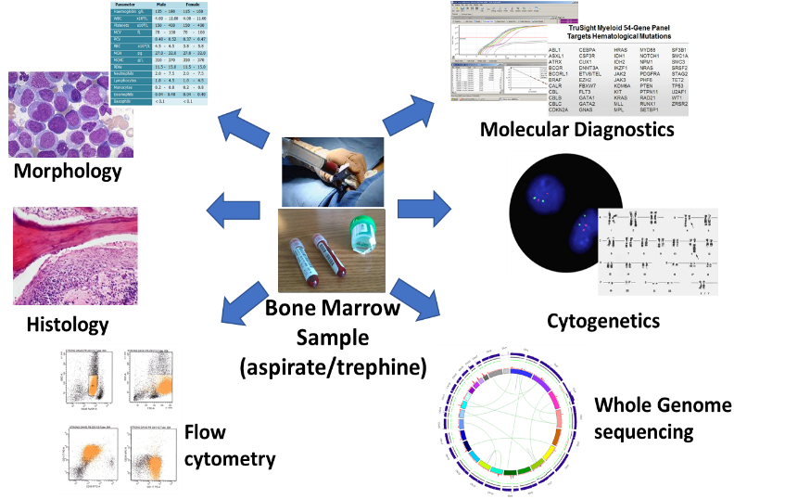
Integrated diagnostic reporting in Haematological Malignancies
NICE Guidance:- Haematological cancers: improving outcomes NG47 2016 :- SIHMDs must produce integrated reports that include all information needed for disease management
Principle of “one patient one diagnosis one report”
Essential to understand and assess all diagnostic results (phenotypic and genomic) to ensure correct delivery of personalised treatment.
Phenotypic Results
Genomic Results

Slide 32
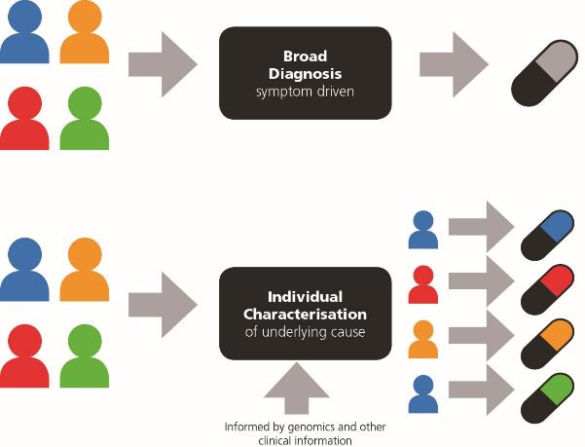
Using this knowledge: The end of the ‘one size fits all’ era of medicine
Traditional approach
Everybody receives the same medicine – typically only 30-60% effective
Personalised approach
Tailored treatment to match an individual’s makeup & response – more effective and fewer side-effects
Informed by genomics & other clinical information

Slide 33
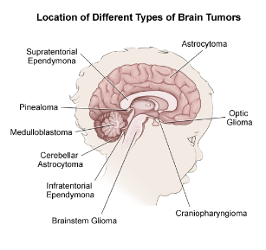
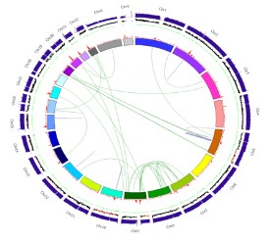
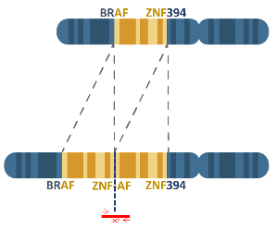
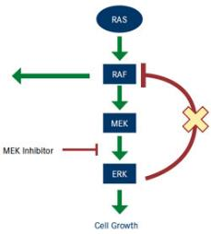
Paediatric brain tumour
Urgent review of WGS requested and revealed a novel BRAF fusion the result of a 40Mb tandem duplication. The fusion wouldn’t have been detected by conventional testing
Clinical Impact
Clinician applied for MEK inhibition therapy following discussion with experts in paediatric brain tumours in Heidelberg.
11 year old child with an atypical astrocytic brain cancer.
Tumour resected but patient relapsed shortly after
Patient Impact
After conventional therapy has failed WGS has given the family the opportunity to access personalised targeted therapy
The BRAF breakpoints conserve the kinase domain and exclude the autoregulatory domain - similar mechanism to previously described BRAF fusions e.g. KIAA1549-BRAF in pilocytic astrocytoma
Data courtesy of East Of England NHS GMC
Notes:
Clinical impact example Paediatric Brain Tumour
Child with relapsed brain cancer. WGS shows a novel BRAF fusion which wouldn’t have been detected by conventional testing. Fusion confers sensitivity to MEK inhibitors

Slide 34


National hurricane center: best hurricane tracking models
Workshop: Towards in Silico-Guided Clinical Trials in Cancer
May 15th-16th, 2019, at Scandic Holmenkollen Hotel in Oslo, we organise a two-day workshop "Towards in Silico-Guided Clinical Trials in Cancer".
Time and place: May 15, 2019 - May 16, 2019, Scandic Holmenkollen Hotel
Novel concepts for personalised cancer medicine
We bring to Oslo experts in fields such as systems medicine, mathematical oncology and bioinformatics to discuss novel clinical trial concepts for personalised cancer medicine.
Please see the workshop website for more information and registration.

Slide 35
Vision for Personalised Medicine
Genomic testing included within medicines access pathways
Horizon scanning of new treatments with associated genomic tests/companion diagnostics
Linked priorities for genomics & medicines optimisation implementation
Pharmacy leads within GMS Alliances supporting links to regional medicines optimisation committees and networks
Including genomics within national programmes e.g. Medicines Value Programme
Utilisation of lab and clinical datasets to ensure equitable access
Linking genomic lab data (e.g. testing volume, results, turnaround time) to clinical datasets (e.g. dose adjustments, toxicity, prescribing patterns)
To determine impact of implementation and variation in access to testing or treatments
Pharmacogenomics incorporated into routine prescribing
Clinical guidelines, decision support and education & training to support the workforce
Patient held information on pharmacogenomic test results
Implementation across both primary and secondary care pathways
Branching into wider opportunities for personalised treatment approach
Early detection and prevention e.g. familial hypercholesterolaemia and statins
Pathogen genomics and opportunities for targeted treatment (e.g. hepatitis C) and antimicrobial stewardship (e.g. MDRTB)
Early impact assessment to support implementation via the genomic test directory
GMS Alliance Research Collaboratives – access to clinical trials for personalised treatments

Slide 36


Key challenges to embedding genomics in mainstream care -

Slide 37
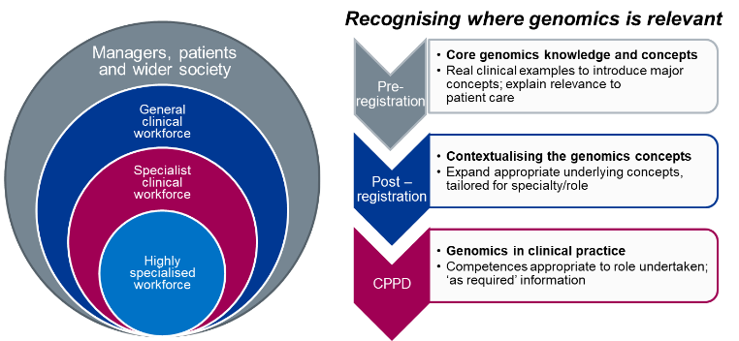
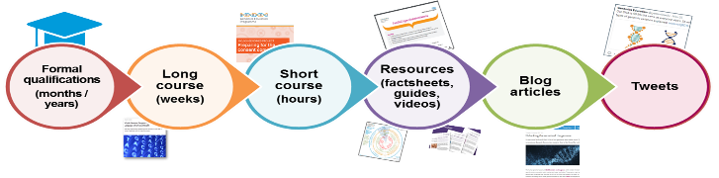
Addressing the challenges of developing the workforce
Resources to support upskilling tailored to suit professional & clinical need
HEE Genomics Education Programme provides a wide range of free-to-access resources to provide an ‘anytime, anyplace, anywhere’ approach to education – tailored to suit the range of professional requirements, and the time & immediate need for education
HEE GEP cumulative data
80,000+
total staff reached
1,400+ Master’s framework places
1.8 million+
web page views
550,000+
resource views
55,292
course registrations
21,000+
MOOC registrations
Resources and material at genomicseducation.hee.nhs.uk and www.futurelearn.com

Slide 38
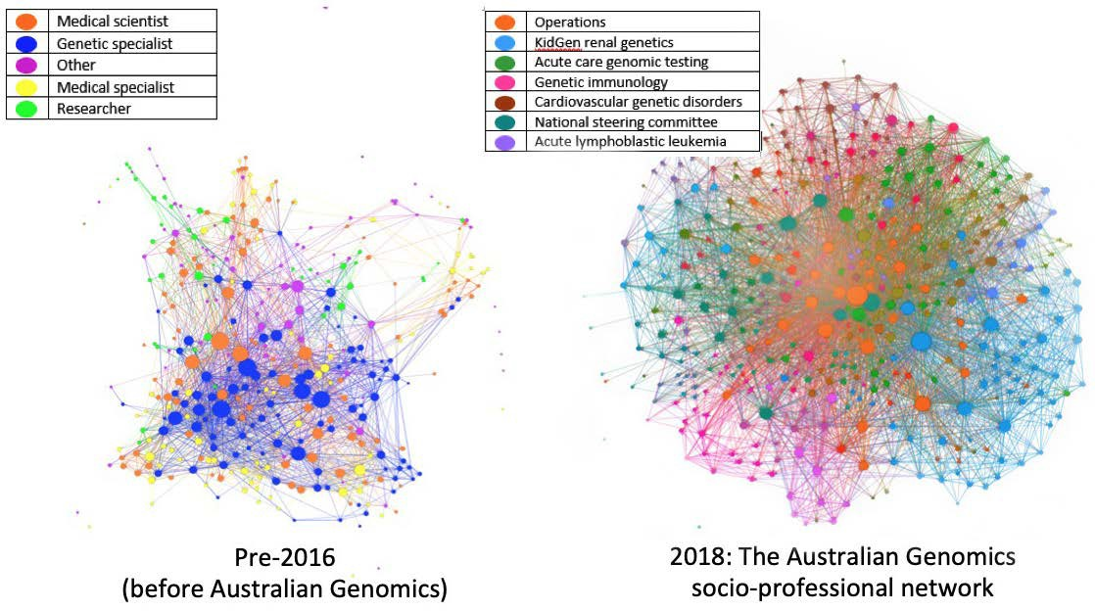

Building a learning community of clinical genomics
A SOCIAL NETWORK STUDY
Long JC, Pomare C, Best S, Boughtwood T, North K, Ellis LA, Churruca K, Braithwaite J. Building a learning community of Australian clinical genomics: a social network study of the Australian Genomic Health Alliance. BMC Medicine. 2019. 17 (1) : 44.

Slide 39
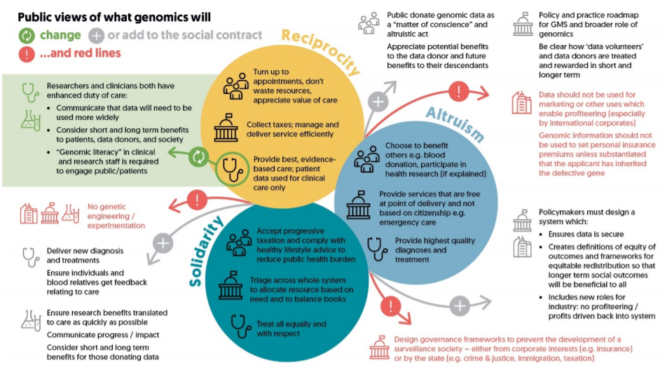
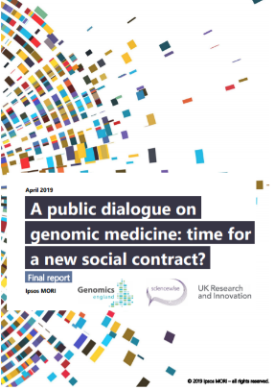
Retaining & building public trust

Slide 40



Working within an ethical framework as we build a genomic future
Working at speed of public acceptance
Choice & consent
Engage and work with the public
Recognise ethics of diagnostics can be dynamic – eg. HIV testing
Consider and address the big questions about when appropriate to carry out WGS within the life course

Slide 41















South West Genomic Services Educational Partnerships
Continuing Professional development – upskilling existing staff
Clinical and Professional
during
training
‘ Socialising’ the Genome- engagement and awareness raising
Supporting research projects
& and honorary/clinical academic contracted staff
HEE Introduction to Variant Interpretation Residential Course ~ February 2020
HEE Introduction to Genomics and Counselling for Nursing
30 Cancer and Cardiac Specialist nurses in current cohort – blended virtual learning
Introduction to Genomics & NHS Services
all undergraduate nurses, midwives, associate nurses, AHPs, Healthcare Scientist and medical students
Intercalated BSc Genomic Medicine – 3rd Cohort
HEE MSc Genomic Medicine
Co-delivery PGCert modules
Exeter continuing to offer full modular repertoire- large alumni in region
School and Science Festival Genomic Lego tool

Slide 42

Responding to a public heath crisis -
Genomics and SARS COV 2

Slide 43
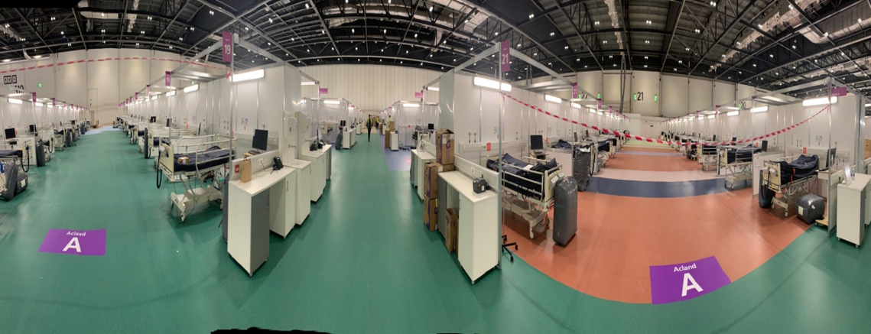
COVID-19 in the UK
1.57m Cases, 57,031 Deaths (John Hopkins University - 27th Nov 2020)
Figures from 27th November 2020

Slide 44
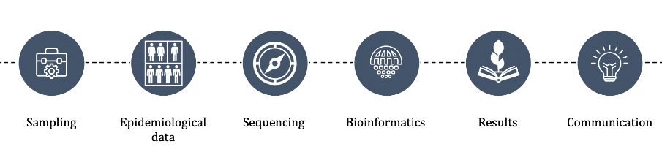
COVID-19 Genomics UK (COG-UK) Consortium
Purpose
To generate scientific evidence to demonstrate where SARS-CoV-2 sequencing can bring benefit to public health
Vision
To establish end-to-end SARS-CoV-2 sequencing and provide information in a relevant time frame to Public Health Teams for action

Slide 45
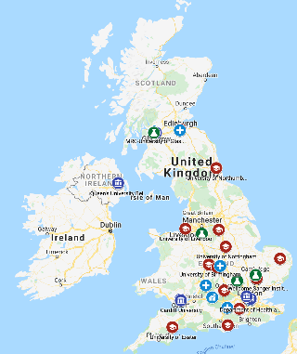
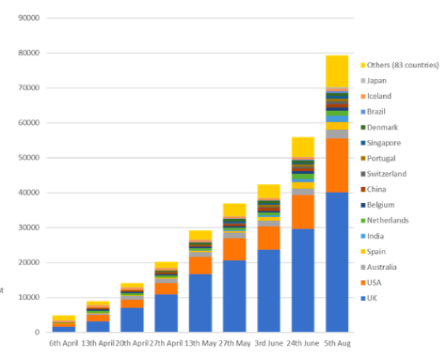

COVID-19 WGS Testing Across the UK
COG-UK is a partnership that comprises:
NHS organisations
Four UK Public Health Agencies
The Wellcome Sanger Institute
Numerous academic partners providing sequencing and analysis capacity

Slide 46

Work streams and external study linkages
UK Immunology network
Sentinel genomic surveillance
Support to national COVID-19 projects
Mutational analysis and tracking
Transmission & outbreak investigation

Slide 47
Severely ill patients with proven COVID-19
Mildly affected patients with proven COVID-19
Genomics England Dataset
UK Biobank Dataset
Cohort
Key core clinical dataset
Longitudinal life-course follow-up
Viral genome (PHE)
Human whole genome sequence of up to 20,000 severely ill patients
Key core clinical dataset
Longitudinal life-course follow-up
Viral genome (PHE)
Human whole genome sequence of up to 15,000 mildly affected patients
WGS of 97,000 participants
627 families with primary immunodeficiency
Longitudinal life-course follow-up
500,000 participants, 40-69 years with exomes available during 2020 (50K WGS soon)
Longitudinal life-course follow-up
Data
Immunodeficiency variant analysis
Viral infections research GeCIP
Extreme case : mild control analysis
Case control analysis
    Case control analysis
Analysis
Power: Severe versus mildly affected offers 80% power to detect genome-wide significance at
low (~1.1) relative risk at 20% risk allele frequency
Outputs
Host vs. viral genomic architecture and susceptibility
Polygenic risk scores for flu-virus susceptibility
Identification of new host genomic variants
Therapeutic Targets & repurposing

Slide 48
Key highlights
7 genome wide significant loci detected
3 potential therapeutic targets
CCR2 – chemokine receptor affects monocyte migration into the lung - biologic tested in rheumatoid arthritis and psoriasis
Interferon 2 Receptor – potential target interferon but trial suggests doesn’t help in severe cases - ? Timing
Tyrosine kinase 2 – Jak1/Jak 2 inhibitors e.g. Baracitinib
Identifying the genetic reason for why some people experience mild symptoms, some experience none at all and some have severe/life-threatening reactions will better enable us to better tailor management and treatment options for patients.

Slide 49
Closing remarks

Slide 50
Outcomes and impact
National patient choice framework
Improved outcomes for cancer
Identify eligibility for clinical trials
Better diagnoses for rare disease
Increased diagnostic repertoire
Mulitomic approach
Personalisation of treatments and interventions
Patient and public education
New options for prediction and prevention of disease
New partnerships- patients, industry, academia, internat’l
Assessment of the genomic workforce
Integrated national genomic data repository
Opportunities:
Rare and inherited diseases
Cancer
Common Non-communicable disease (eg CVD, diabetes)
Other clinical priority areas (Mental Health, Dementia, learning disability)
Infectious disease (inc antimicrobial resistance)
COVID-19
Prevention and prognostics
Pharmacogenetics

Slide 51
“It’s not easy to be a pioneer – but oh, is it fascinating”
Elizabeth Blackwell

